Slide 1
Functional English Lecture 1
Formal and Informal Language

Slide 2
Overview of the Course
weeks | Topics | Evaluation | CLO
1 | Characteristics of Formal Writing |  | 1
2 | Basics of Formal Writing: Phrase, Clause, Sentence | [A1] | 1
3 | Basics of Formal Writing: Conjunctions | [ A1] | 1
4 | Sentential Errors: Fragments, Run-ons, S/V agreement
5 | Introduction to Academic Writing-> Writing process | [Quiz 1] | 2
6 | Midterm 1
7 | Basics of Academic Essay writing- Making Outlines |  | 2
8-9 | Basics of Academic Essay Writing- Paragraphs | [Quiz 2] | 1+2
10 | Writing Academic Essay [Scientific/Informational Article] | [A 2] | 2
11 | Editing and Revision: Mechanical errors, improving ideas |  | 3
12 | Midterm 2
13-15 | Writing different types of essays: Compare and Contrast, Argumentative Essay, Problem Solution Essay | [Project] [Quiz 3] | 3
16 | Revision [Project Submission]

Slide 3
Features of Formal Language
Well Planned
Formal vocabulary
Delayed Feedback
No contractions
Impersonal Language
Less complex
Standard Grammar

Slide 4
Techniques to Formalize Statements
Change to Third Person
Use Passive Voice
Use Indirect Questions
In case of inquisitive sentences [questions] change to indirect questions
In case of statements, use passive voice
He/She/It Him/ Her Their/Them.. etc

Slide 5
Third Person
Pronouns
Descriptive words
The author
The player
The reader
He/ she/ It
Him/Her, They/Them
Used in most formal academic writing

Slide 6
Passive Voice- Statements
Example
Because of the bad weather, the manager closed the mall.
The mall has been closed by the manager because of the bad weather.
Use indirect sentences or reported Speech

Slide 7
Indirect Questions
Ask Indirect questions in the following situations
Ask for information
Ask Indirect questions:
When you want to be polite
Use the following introductory phrases for indirect questions
Can/could you tell me….
Ask for help
Make requests
When you are uncertain about the degree of formality required
When you are uncertain whether the addressee knows the answer to your question
Do you know…..
Can you show…
Would you mind…..
When talking to people you are not well acquainted with

Slide 8
Formal Vocabulary
Gobsmacked
Knackered
Gonna be
Howdy
Kinda
Kids

Slide 9
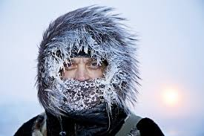
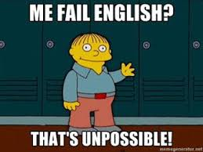
Objectivity
Evaluate the following statements:
I think the weather is really nice today.
I believe it is easy to secure good
grades in English.
Do not use personal pronouns or opinions that can be disagreed with..

